Slide 1



AI-Driven Real Time Portfolio Risk Alert System
BOBBILI SAI SIDDHARTHA

Slide 2
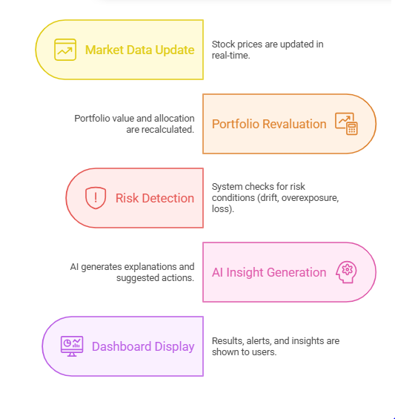
ABSTRACT
This project focuses on building a system to monitor portfolio performance in real-time
It uses a microservices and event-driven architecture on AWS
The system continuously tracks portfolio value using market price updates
It identifies key risks such as allocation imbalance and sudden losses
AI is used to generate clear explanations and suggestions
All insights are displayed through a simple dashboard

Slide 3
PROBLEM STATEMENT
Investors do not have an easy way to track their portfolio continuously
Most existing solutions provide delayed or manual insights It is difficult to quickly identify: Risk conditions
Portfolio imbalance
There is a lack of systems that provide intelligent explanations
Hence, a system is needed that can detect risks automatically and provide insights in real-time
OBJECTIVE
Track portfolio value in near real-time
Detect risk conditions automatically
Generate AI-based explanations
Provide actionable recommendations
Display results on a simple dashboard

Slide 4
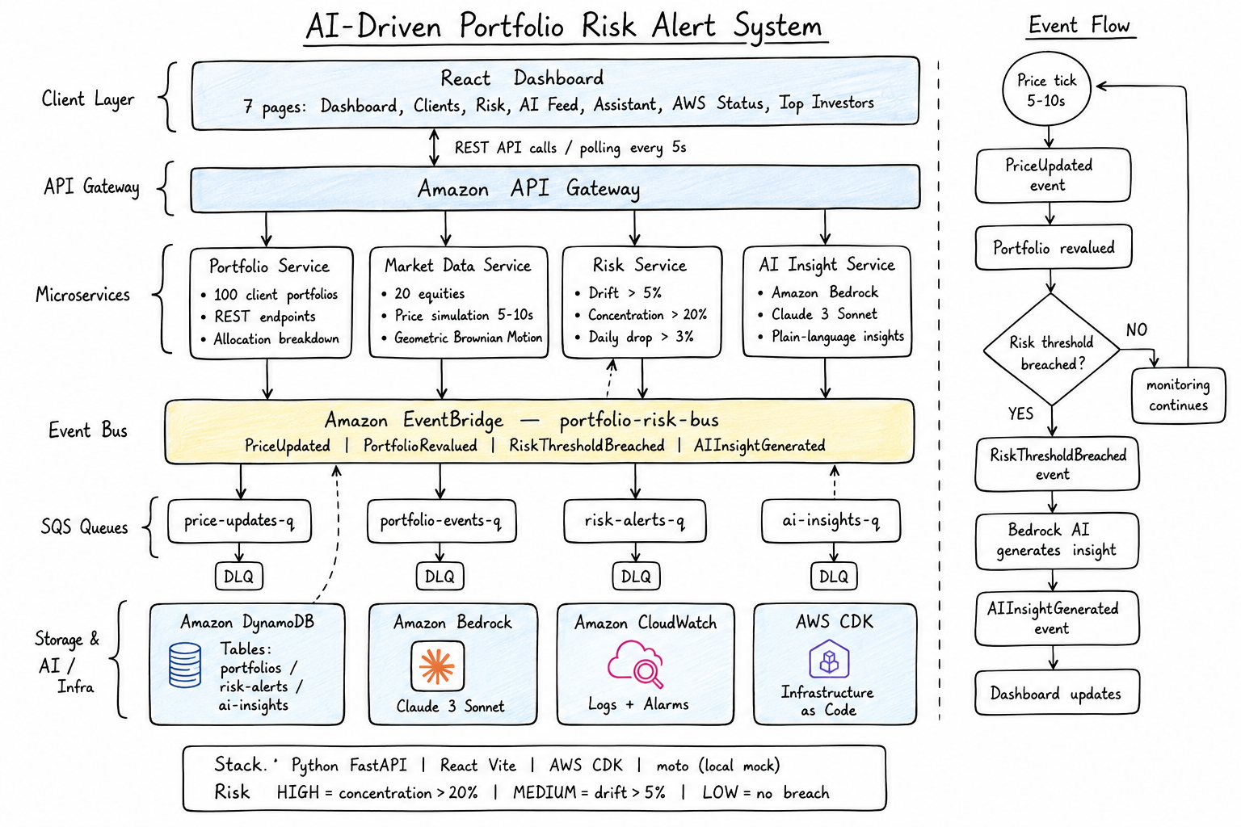
SYSTEM ARCHITECHTURE

Slide 5
What Was Built
A fully working, end-to-end system — locally runnable, production-deployable
Backend
Frontend
FastAPI
React + Vite
Single process · 4 APIRouter microservices
auto-refreshes every 8 seconds
main.py
Dashboard
all logic in one deployable unit
Live AUM · risk counts · 20 equity prices
AWS Mocking (moto)
Clients Page
DynamoDB, SQS, EventBridge — in-memory
All 100 portfolios with AI insights per card
Price Simulation
Risk Analytics
Background thread every 5–10 seconds
Tabbed HIGH / MEDIUM / LOW + alert table
Structured Logging
AI Feed
CloudWatch-compatible JSON format
Live stream of risk breach alerts
Uvicorn ASGI
AI Assistant
Server runs on port 8000
Chat UI · 15 intent patterns · fuzzy match

Slide 6
MICROSERVICES(API)
PORTFOLIO
MARKET DATA
GET /portfolio-service/clients → Fetch all client portfolios
GET /portfolio-service/portfolios/{client_id} → Get specific portfolio
POST /portfolio-service/admin/seed → Initialize sample data
GET /market-data-service/prices → Get all stock prices
GET /market-data-service/prices/{ticker} → Get price of a stock
GET /market-data-service/feed/{client_id} → Real-time activity feed
RISK
AI INSIGHT
GET /risk-service/alerts → Get all risk alerts
GET /risk-service/alerts/{client_id} → Client-specific alerts
GET /risk-service/analytics → Risk analysis summary
GET /risk-service/revalued/{client_id} → Portfolio revaluation data
GET /ai-insight-service/insights → Get AI-generated insights
GET /ai-insight-service/insights/{client_id}/latest → Latest insight
POST /ai-insight-service/query → AI assistant query

Slide 7
EVENT-DRIVEN PIPELINE
Market Data
Service
EventBridge
PriceUpdated
Risk Service
run_risk_check()
EventBridge
RiskThresholdBreached
AI Insight
Service
Price tick
5–10s interval
portfolio-risk-bus
price-updates-q
10 portfolios
per cycle
PortfolioRevalued
also published
Bedrock / mock
JSON output
→
→
→
→
Event Schemas (defined JSON structure)
PriceUpdated
PortfolioRevalued
RiskThresholdBreached
AIInsightGenerated
{ "event_type": "PriceUpdated", "ticker": "AAPL", "price": 187.45, "change_pct": 1.05 }
{ "event_type": "PortfolioRevalued", "client_id": "CL-1005", "total_value": 142350.75, "daily_change_pct": 1.53 }
{ "event_type": "RiskThresholdBreached", "client_id": "CL-1042", "risk_level": "HIGH", "breach": "Single stock exposure exceeded" }
{ "event_type": "AIInsightGenerated", "risk_level": "HIGH", "suggested_action": "Rebalance portfolio to reduce risk" }
Enables real-time communication between services by publishing stock price updates.
Generated after recalculating the portfolio value and is used to track performance and trigger further risk analysis.
Generated when portfolio risk limits are exceeded and is used to trigger AI-based insights and alerts.
Generated after AI analyzes the risk and provides a clear explanation along with suggested actions

Slide 8
RISK DETECTION LOGIC
System checks risk conditions after every price update
📊 Allocation Drift
🔴 Single Stock Overexposure
📉 Daily Portfolio Drop
Compares actual allocation with target allocation
Detects imbalance in portfolio distribution
Alert triggered if deviation exceeds 5%
Checks how much a single stock contributes to the portfolio
Identifies concentration risk
Alert triggered if one stock exceeds 20%
Measures change in portfolio value over a day
Detects sudden losses
Alert triggered if portfolio drops more than 3%
System Behavior
Runs after every price update event
Continuously evaluates all portfolios
Generates RiskThresholdBreached event if any condition is met

Slide 9
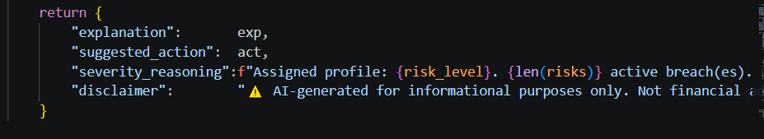
AI Insight Engine
Production — Amazon Bedrock
Local — Python Rule Engine
Uses advanced AI model to generate insights
Transforms risk data into clear, human-readable explanations
Provides actionable recommendations for investors
Returns structured and consistent JSON output
Uses predefined logic to simulate AI behavior
Handles different risk conditions efficiently
Ensures consistent and reliable output format
Includes mandatory advisory disclaimer
Output JSON Schema

Slide 10
AWS SERVICES
1. Amazon API Gateway
2. AWS Lambda
3. Amazon DynamoDB
Used as the entry point for all client requests
Routes API calls to different microservices
Enables secure and scalable API access
Used to run backend logic for each microservice
Handles portfolio processing, risk detection, and AI flow
Provides serverless execution and automatic scaling
Stores portfolio data, risk
alerts, and AI insights
Enables fast and real-time data retrieval
Suitable for scalable NoSQL storage
4. Amazon EventBridge
5. Amazon SQS
6. Amazon CloudWatch
4 queues: price-updates-q, risk-alerts-q, ai-insights-q, portfolio-events-q
Provides decoupling between microservices
Created via sqs_client.create_queue() at startup
Queue URLs auto-discovered from moto
Structured JSON log format throughout
Fields: time, level, service, msg logging.basicConfig() with JSON format string
Warnings on RiskThresholdBreached events
Used for event-driven communication between services
Publishes and routes events like: Price updates
Risk alerts
Ensures loose coupling between microservices

Slide 11
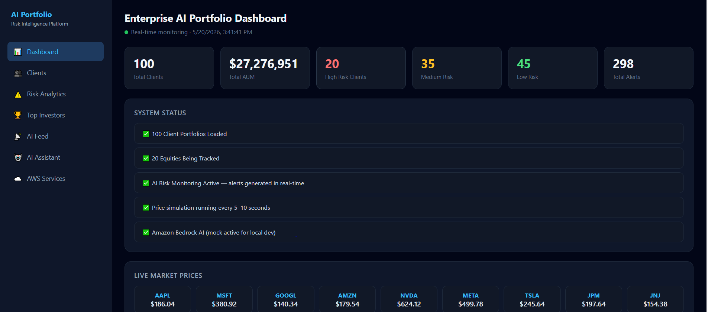
DASHBOARD
Real-time portfolio monitoring , Risk distribution across clients , Live market price updates, Automated risk alerts and AI-generated insights

Slide 12
FUTURE ENHANCEMENTS
Implement separate login for Admin and Clients with role-based access
Deploy the system on real AWS cloud for scalability and production use
Integrate live stock market APIs for real-time data instead of simulation
Add AI voice assistant for interactive portfolio queries
Enhance system with advanced risk analytics and predictive insights

